Slide 1

Unit 3: Tool Command Language (Tcl) Fundamentals
In this unit you will learn about the Tcl fundamentals that allow you to build full-featured programs in ENOVIA V6. You will also learn how to invoke MQL commands from within Tcl programs.
Tcl is a simple scripting language for controlling and extending applications.
It provides generic programming facilities, such as variables, loops and procedures, and it also allows for embedding MQL commands. In this unit you will learn how to do this.
ENOVIA V6R2013x includes a Tcl interpreter at release level V8.5 (puts $tcl_version).
Lesson content:
Lesson 1: Understand Tcl Fundamentals
General syntax.
Variable and command substitution.
Invoke MQL commands from within your Tcl code
Difference between double quote and brace grouping
Lesson 2: String and List Manipulation
Lesson 3: Control Flow and Exception handling
Lesson 4: Tcl Program Objects and RPE
3 hours
3-1

Slide 2
Lesson 1: Understand Tcl Fundamentals
In this lesson you will learn the basics of the Tcl scripting language and some basic Tcl commands.
Here are the topics to be covered:
Understand Tcl Fundamentals
String and list manipulation
Control Flow and Exception handling
RPE and Tcl Trigger Programs
3-2

Slide 3
TCL Basics
What is TCL (Tool Command Language)?
TCL (Tickle) is an interpreted programming language for controlling and extending MQL
Tcl is supported on multiple platforms (UNIX, Linux, Windows, Mac OS)
Each command consists of one or more words separated by spaces
Provides full set of programming features like variables, loops, arrays and procedures
To enter TCL mode, give the command: tcl; on the MQL prompt
The same command can be given in a script also. After this command, all the statements are interpreted by the TCL interpreter
To run an MQL command when in TCL mode, prepend the command with the word “mql”

Slide 4
Capabilities
Tcl provides the following capabilities:
Variables, Arrays and Lists Allows for easy storage and manipulation of data.
String Manipulation Searching, parsing, and sorting data.
Flow Control Condition testing, loop control, procedures, and error trapping.
Procedures User defined subroutines and functions.
File Access Reading, writing, and manipulating files
Process Execution Running external programs
3-4

Slide 5

Tcl Scripts
Commands entered in an ASCII text file and then evaluated by the Tcl interpreter
Text file evaluated using the source command. source “c:/Class Files/MyProgram.tcl”
3-5

Slide 6
General Syntax
Tcl scripts contain one or more Tcl commands separated by newlines or semicolons (;)
Tcl commands consist of a set of words separated by spaces.
The first word in a Tcl command is the name of the command. The rest of the words are the command arguments.
Tcl commands and variables are case sensitive.
3-6

Slide 7
Variables
In Tcl all variables are type string and therefore variables cannot be declared.
All variables and values are case sensitive.
Variable names and values can be arbitrary strings of characters.
Values are assigned to a variable with the set command
set sMyvar “Hard Disk”
set iCount 23
Variable names can also be any arbitrary set of characters:
set 456*9899-33 100
Sets a variable named 456*9899-33 to the value of 100.
Although the language supports this syntax it is not recommended for maintenance and program readability.
3-7

Slide 8
Substitution
Defines how and when values will be substituted for words in a Tcl command.
Tcl parses a command and makes substitutions in a single pass from left to right.
The result of one substitution is not scanned for further substitutions.
Types of substitution:
Variable Substitution
Command Substitution
Character Substitution
3-8

Slide 9
Variable Substitution -> Accessing Variable Values
Use the Dollar sign ($) to invoke variable substitution.
The $ and the following word (variable name) are replaced by the current value of the variable.
The replaced value is considered to be a single argument to the command, even if it contains spaces.
The character following $ must be alphanumeric or an underscore.
Examples: set sMyvar “Hard Disk”
puts $sMyvar
=> Hard Disk
set iCount 23
puts $iCount
=> 23
The Tcl command ‘puts’ echoes back a value to standard output (typically the screen).
3-9

Slide 10
Command Substitution
Square Brackets ([ ]) invoke command substitution. The text inside the brackets is evaluated as a separate Tcl script. The brackets and the text are replaced by the result of that script.
Used to nest one Tcl command within another Tcl command
set iResult [ expr 2 + 2 ]
=> 4
Results: The [ ]’s cause the text inside to be executed. The result (4) is substituted for the [ ]s and the text, and assigned to the variable.
Tcl command ‘expr’ is used for arithmetic expressions.
3-10

Slide 11
Embedding MQL Commands in Tcl Code
In order to be able to invoke MQL commands in Tcl they must be prefixed with the ‘mql’ keyword.
Use Tcl command substitution to access MQL commands.
The results of MQL commands are returned to Tcl as a string.
Results can then be post-processed using Tcl commands.
Examples: mql list bus
=> Displays list of business objects in Tcl to standard out.
set sPersons [mql list person]
=> Sets variable to list of all persons in ENOVIA database.
set sRole [mql print role Shipper] => Sets variable to print role output of Shipper.
All mql command must be prefixed with the word ‘mql’ in order to be able to execute them in the Tcl code.
3-11

Slide 12
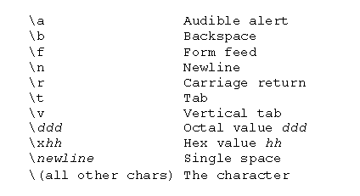
Character Substitution
Used to access special characters.
Backslashes (\) invoke character substitution. The backslash and following character are removed and replaced with a special character:
Backslash is similar to the ESCAPE character in other programming languages.
3-12

Slide 13
Line Continuation Character
Use \ newline as the line continuation character in Tcl code.
Example:
set sParts [mql expand bus \
“System Box” “Metro0001” A from recurse to all]
The Tcl parser reads a \ followed by a newline as a single space - in effect replacing the newline with a space character. Tcl then reads the command/variables as a single line.
3-13

Slide 14
Suppressing Command Substitution
The \ is also used to suppress substitution.
Example: set sSrc [mql print bus Monitor NEC350 A select attribute\[Source\] dump]
Results:
The \[ and \] prevent command substitution from occurring on the attribute Source.
If the \ characters are omitted a syntax error will occur as Tcl attempts to call a command named Source.
3-14

Slide 15
Grouping
Grouping is used to combine multiple words into one argument for a command. Example: set sMyvar “Hard Disk”
Grouping is always performed before substitution when Tcl parses a command. Tcl makes a single pass through a statement to determine groups.
In Tcl two types of grouping exist:
Double Quotes “ ” - Allow substitutions to occur.
Curly Braces {} - Prevent substitutions in a group.
3-15

Slide 16
Double Quote Grouping
Variable, command, and character substitutions occur as usual within double quotes. Any spaces, newlines, and semicolons found between double quotes are considered part of the same command argument. Examples: set iNum 99 puts “The value of iNum is $iNum” => The value of iNum is 99 puts “Some text; and \n more text” => Some text; and
=> more text
Since the newline and semicolon are within double quotes, they do not terminate the Tcl command. Also, everything within the double quotes is considered to be one word or argument to the puts command.
3-16

Slide 17
Brace Grouping
Variable, command, and character substitutions DO NOT occur within brace quoting (unless the braces are contained within double-quotes).
Braces ({ }) disable all character substitution except backslash-newline (line continuation).
Useful to defer evaluation (as in procedures and certain Tcl commands). Examples: set iCount 99 puts {The value of iCount is stored in $iCount} => The value of iCount is stored in $iCount
The multiple words in the puts statement are grouped with curly braces as one argument to puts. Curly braces prevent variable substitution to occur on $iCount.
The Tcl command eval arg ?arg arg …? can be used to evaluate the mql command defined within brace grouping (allows for postponing evaluation): set cmd {mql print type $sType select policy} | | | | | | set sType “Monitor“ eval $cmd
3-17

Slide 18
Tcl Comments
A hash/pound symbol (#) designates the start of a comment.
The comment is terminated by a newline.
The # must be the first non-blank character of the comment.
Example:
# This is a comment
puts “hello there”; # Need semicolon before # this comment
3-18

Slide 19
Variable Commands
So far you have already seen the variable command set which is used to make a variable assignment.
Variable commands work directly with Tcl variables to modify the value of the variable based on the command type.
Other commands include:
incr
unset
expr
3-19

Slide 20
incr
Syntax:
incr varName ?increment?
Description: Concatenates all the values and appends them to the end of the variable, creating the variable if it doesn’t exist.
Example: set iSize 2
incr iSize 2
puts $iSize
=>4 set iCost 25
incr iCost 25
incr iCost -25
puts $iCost
=>25
The ‘incr’ command only works with whole integers. The above example is the same as:
set iSize [expr $iSize + 2]
3-20

Slide 21
unset
Syntax: unset varName ?varName …?
Description: Removes variables(s) and their values from memory.
Example: unset iSize sName
Results: The iSize and sName variables are deleted from the local heap.
Once a variable is removed the value(s) assigned to that variable no longer exist(s). Note that when a Tcl program ends the variables and all values declared in the program are automatically removed from the local heap.
3-21

Slide 22
expr
Syntax: expr arg ?arg arg …?
Description: Concatenates all the arguments and evaluates them as an expression.
Example: expr (10/2) + 3 =>8
Results: The expression is evaluated and returned as a string.
3-22

Slide 23
Variable & Command Substitution & Grouping
In this step you will:
Use the Tcl set command.
Use command substitution.
Use various Tcl commands to interact with variables.
10 minutes
3-23

Slide 24
Do It Yourself
Using the MQL command editor in Tcl mode set a variable named iCost to 33.
Use a Tcl command to output to the screen the following: The value of iCost is 33
Now output to the screen the following by disabling Tcl substitution: The value of iCost is stored in $iCost
Set a variable named sMatrixUser to the value of ‘Dave’.
Change the current person context to the value of sMatrixUser. Check to make sure the context has been changed.
Create a variable iTotal that stores the number 50. Increment the number by 25.
Set a variable iCost equal to 0. Now use a Tcl command that adds 20 to iCost and then divides that number by 2. Why is a Tcl command required to perform arithmetic operations?
Set a Tcl variable named sType to ‘System Box’. Set another variable named sName to ‘Metro0001’. Set a third variable named sRevision to A.
Expand all the subassemblies of a business object using the variables you created in step 8. 1 System Box Assembly to CD-Rom Toshiba 56X A
2 Documentation to Spec Sheet CD-Rom Toshiba 56X 1
1 System Box Assembly to Video Card Diamond 3D 64MB A
2 Documentation to Spec Sheet Video Card Diamond 3D 64MB 1
1 System Box Assembly to RAM Module Micron 128MB A
2 Documentation to Spec Sheet RAM Module Micron 128MB 1
3-24

Slide 25
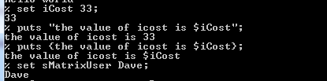



Do It Yourself

Slide 26

Lesson 2: String and list Manipulation
In this lesson you will learn the Tcl commands to manipulate strings and Tcl lists.
Here are the topics to be covered:
Understand Tcl Fundamentals
String and list manipulation
Control Flow and Exception handling
RPE and Tcl Trigger Programs
3-25

Slide 27
Introduction – Tcl String Manipulation Commands
Tcl provides commands search through, compare, format, scan, convert, sort and trim strings.
3-26

Slide 28
Tcl String Manipulation Commands
The following Tcl commands are available that allow you to manipulate strings.
format
string compare
string first / string last
string index
string length
string match
string range
string tolower / string toupper
string trim / string trimleft / string trimright
3-27

Slide 29
Tcl ‘string length’ Command
Syntax:
string length string
Example: string length “A test string” ==>13
Results: Returns the number of characters in the string, 13.
3-28

Slide 30
Tcl ‘string index’ Command
Syntax: string index string charIndex
Example: string index “Hello World” 4 ==>o
Results: Returns the 4th character in the string, “o”.
3-29

Slide 31
Tcl ‘string range’ Command
Syntax: string range string first last
Example:
string range “A test string” 7 end
==>string
Results:
The substring from character 7 to the end is returned.
3-30

Slide 32
Tcl ‘string first’ and ‘string last’ Commands
Syntax: string first string1 string2
Example:
string first “!” “Help!Me!”
==>4
Results: Finds the first ! at index 4 of the second string.
Syntax: string last string1 string2
Example:
string last “!” “Help!Me!”
==>7
Results: Finds the first ! at index 7 of the second string.
3-31

Slide 33
Tcl ‘string compare’ Command
Syntax:
string compare string1 string2
Example:
string compare “First” “Second”
==>-1
Results:
“First” is less than “Second”, so a -1 is returned.
3-32

Slide 34
Tcl ‘string match’ Command
Syntax:
string match pattern string
Example:
string match “*test*” “A test string”
==>1
Results: The pattern matches the string, so a 1 is returned.
3-33

Slide 35
Tcl ‘string tolower’ and ‘string toupper’ Commands
Syntax: string tolower string
Example:
string tolower “A Test String”
==>a test string
Results:
All the uppercase characters are converted to lowercase.
Syntax: string toupper string
Example:
string toupper “A Test String”
==>A TEST STRING
Results:
All the lowercase characters are converted to uppercase.
3-34

Slide 36
Tcl ‘string trim’, ‘string trimleft’ and ‘string trimright’ Commands
Syntax: string trim string ?chars?
Example:
string trim “ A test string !!!!” “ !”
==>A test string
Results:
Removes all spaces and !’s from left end of the string.
Syntax: string trimleft string ?chars?
Example:
string trimleft “ A test string !!!!” “ !“
==>A test string !!!!
Results:
Removes all spaces and !’s from right end of the string.
Syntax: string trimright string ?chars?
Example:
string trimright “ A test string !!!!” “ !“
==> A test string
3-35

Slide 37
format Command
Syntax:
format formatString ?value value …?
Example:
format "The %s number %d is %x in %s" \
decimal 23 23 hex ==>The decimal number 23 is 17 in hex
Results: A string is printed using the format defined.
3-36

Slide 38
Introduction – Tcl List Manipulation Commands
A Tcl List is an ordered set of items containing any string value separated by white space. Lists can be nested to any level and are useful to process information returned from MQL commands.
Tcl List structures allow you to work with 3DEXPERIENCE Platform data easily and to parse specific data from a result.
Tcl Lists are considered a special kind of string in Tcl.
Rather than dealing with collections of characters, Tcl Lists deal with collections of elements, which become very useful with the results of MQL commands from 3D Experience Platform.
3-37

Slide 39
Tcl List Manipulation Commands
The following Tcl commands are available that allow you to manipulate Tcl Lists:
list concat lappend
llength lindex lrange
linsert lreplace
lsearch
lsort
split
3-38

Slide 40
Tcl list Command
Syntax: list ?value value …?
Example:
set lComps [list Memory Mouse “System Box”]
=>Memory Mouse {System Box}
Results: A list is created from the arguments and stored in the lComps variable.
3-39

Slide 41
Tcl concat command
Syntax: concat ?list list …?
Example: set lComps [concat $lComps [list Monitor Keyboard]]
=>Memory Mouse {System Box} Monitor Keyboard
Results: The lComps list is concatenated with the list of Monitor and Keyboard to form a new list of Components.
3-40

Slide 42
Tcl lappend Command
Syntax: lappend varName value ?value …?
Example: lappend lComps Monitor
=>Memory Mouse {System Box} Monitor
Results: The lComps list is concatenated with the list of Monitor and Keyboard to form a new list of Components.
3-41

Slide 43
Tcl lindex Command
Syntax: lindex list index
Example: lindex $lComps 2
=>System Box
Results: The 3rd item (index 2) is returned from the lComps list.
3-42

Slide 44
Tcl llength Command
Syntax: llength list
Example: llength $lComps
=>5
Results: Returns the number of items in the lComps list.
3-43

Slide 45
Tcl lrange Command
Syntax:
lrange list first last
Example: lrange $lComps 0 2
=>Memory Mouse {System Box}
Results: Items 0 through 2 of lComps are returned.
3-44

Slide 46
Tcl linsert Command
Syntax:
linsert list index value ?value …?
Example: linsert $lComps 2 RAM
=>Memory Mouse RAM {System Box} Monitor Keyboard
Results: The value RAM is inserted before item 2 in the lComps list.
3-45

Slide 47
Tcl lreplace Command
Syntax:
lreplace list first last ?val val…?
Example 1:
lreplace $lComps 2 2 Speicher
=>Memory Mouse Speicher {System Box} Monitor Keyboard
Results: Item 2 of list lComps is replaced with Speicher.
Example 2: lreplace $lComps 3 3
=>Memory Mouse Speicher Monitor Keyboard
Results: Item 3 of list lComps is replaced with nothing.
3-47

Slide 48
Tcl lsearch Command
Syntax:
lsearch ?-glob? ?-exact? ?-regexp? list pattern
Example: lsearch -glob $lComps *r*
=>0
Results: Returns the index of the first item in list lComps that matches *r*, which is Memory, item 0. Drive Mouse RAM Monitor Keyboard. (-1 would be returned if there are no matches).
3-48

Slide 49

Tcl lsort Command
Syntax: lsort ?options? list
Description: Sorts the list based on the specified options and returns it. Options include -ascii, -integer, -real, -dictionary, -increasing, -decreasing, -index x, -command cmd.
Example 1: lsort -ascii $lComps
=>Keyboard Memory Monitor Mouse RAM
Example 2:
set lNames [ list “Dave McNellis” “Angie Smith” “Joe Jackson”]
lsort -dictionary -index 0 $lNames
==>{Angie Smith} {Dave McNellis} {Joe Jackson}
3-49

Slide 50
Tcl split Command
Syntax: split string ?splitChars?
Example:
split [mql list group] \n
=>{HCC Corp} Sales Manufacturing
Results:
The string is split at each instance of the newline character and the resulting list is returned.
3-50

Slide 51
Lists
In this step you will:
Create a Tcl list.
Use various commands to interact with the newly created list.
Use other list commands to interact with the 3DEXPERIENCE Platform database
15 minutes
3-51

Slide 52


Do It Yourself
Using the MQL command editor in Tcl mode set a variable named lsDays that contains the days of the week starting with Sunday.
Output the third day of the week to the screen (Hint: it’s not Weds).
Set a new variable lsWeek that contains the contents of lsDays without the weekend days.
Output the length of lsWeek.
Use an MQL command to set a variable lsGroups equal to a list of group objects in the database.
Output the first item in the list. Is this what you expected? Why does this occur?
3-52

Slide 53
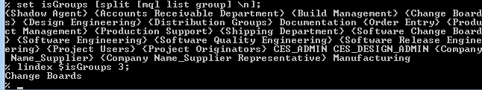

Use the Tcl split command to assign the groups stored in the variable lsGroups to a new list variable named lsSplitGroup. What is the delimiter to split the string?
Now output the first item in the list and note any differences.
Use an MQL command to obtain the attributes Source and Weight from the single businessobject ‘System Box’ ‘Metro0001’ A so that it outputs as the following. (Hint: You will need to use the backslash character to prevent an error condition in Tcl). Intel|0.0
Assign the output of this command to a variable sResult.
Use the split command to assign the value of sResult to a list variable lsResult. What delimiter is required to split this string?

Slide 54
Lesson 3: Control Flow and Exception Handling
In this lesson you will how to control the flow of execution and gently handle any errors that may occur at runtime.
Here are the topics to be covered:
Understand Tcl Fundamentals
String and list manipulation
Control Flow and Exception handling
RPE and Tcl Trigger Programs
3-53

Slide 55
Introduction – Control Flow
Control Flow commands in Tcl allow for conditional testing of variables, looping, and error handling.
They allow your program to react differently based on different situations and values.
These commands typically provide the program logic to your MQL/Tcl programs in 3DEXPERIENCE Platform.
3-54

Slide 56
Tcl Control Flow Commands
The following Tcl commands are available that allow you to control flow of execution in Tcl code (scipts):
break
continue
for
foreach
if
switch
while
3-55

Slide 57
Tcl if Command
Syntax: if test1 body1 ?elseif test2 body2 elseif …? ?else bodyn?
Example: if { $sPart == “Memory” } {
puts “Found Memory”
} elseif {$sPart == “Mouse”} {
puts “Found Mouse”
} else {
puts “Not Found”
}
Results: Print ‘Found Memory’ if the sPart variable is set to “Memory”, otherwise print ‘Not Found’.
Note position of braces
3-56

Slide 58
Tcl switch Command
Syntax:
switch ?options? string {
value body
?default body …?
}
Description: Evaluates the body of the first value that matches string. Options include -exact, -glob, -regexp.
Example:
switch -exact $sType {
Memory {mql print Type $sType}
“System Box” -
Mouse {mql delete Type $sType}
CustOrder {mql mod type $sType XY}
Default {puts “Undefined Type” }
}
Results: Matches the value of sType against the values listed in the command and evaluates the appropriate body.
3-57

Slide 59
Tcl for Command
Syntax:
for init test reinit body
Example:
for {set iNum 0} {$iNum<3} {incr iNum} {
puts $iNum
}
=> 0
1
2
Results:
The loop is executed 3 times printing out 0, 1, and 2.
3-58

Slide 60
Tcl while Command
Syntax:
while test body
Example:
while { $iNum < 10 } { incr iNum; puts $iNum }
Results:
While iNum is less than 10, evaluate the body of the command.
3-59

Slide 61
Tcl foreach Command
Syntax:
foreach varName list body
Description: For each item in list, varName is set to the value of that item and body is evaluated as a Tcl script.
Example:
foreach sRole [split [mql list role] \n] {
puts [mql print role $sRole select name person dump]
}
Results: Prints out each role and persons in each role.
3-60

Slide 62
Tcl break Command
Syntax:
break
Description: Terminates the innermost nested looping command.
Example:
while { … } { break }
Results:
If the break command is reached, then the while command is terminated.
3-61

Slide 63
Tcl continue Command
Syntax:
continue
Description: Stops the current iteration of the innermost nested looping command and goes to the next iteration.
Example:
while { … } { continue }
Results: If the continue command is reached, then control resumes at the while command.
3-62

Slide 64
Introduction – Exception Handling
Exceptions can be caught by Tcl scripts to allow for recovery and better error reporting.
Unless errors are captured using the Tcl error handling commands, the program will fail and the user will be forced to start over.
It is desirable to handle common error situations so that a program can end gracefully or the user has the chance to correct a mistake (e.g. passing a bad filename, object name, etc.).
3-63

Slide 65
Tcl catch Command
Syntax:
catch command ?varName?
Description:
The catch command is executed and any exceptions are caught.
The return from the catch command is a code indicating whether the command caused an exception.
If there was an exception, the error message is placed in varName.
Example:
catch { mql print type Mousx } sMessage
=>1
puts $sMessage
=>Error: #1900068: print type failed
System Error: #1500178: business type ’Mousx' does not exist
Results: The command fails and is caught by the catch command. The catch command returns a value of 1 (error) and sets the message variable to the error message.
3-65

Slide 66
errorCode errorInfo
Reserved Tcl variables contain information on the last error that occurred.
errorCode returns the error code returned from a procedure (if any).
errorInfo returns the the error message text.
3-66

Slide 67
error Command
Syntax:
error message ?info? ?code?
Description: Generates an error with the specified error message, aborts the current Tcl script, and places info into the errorInfo variable and code into the errorCode variable.
Example:
error “Program has caused an error to occur”
Results: An error is generated, the error message is displayed, and the Tcl script is aborted.
3-67

Slide 68
Control Flow (foreach)
In this step you will:
Retrieve all users from the database and put them into a list.
Use a foreach command to output each person name to the screen in uppercase.
Calculate total cost of ‘System Box’ assembly.
20 minutes
3-68

Slide 69
Do It Yourself (1/2)
Using a text editor, create a Tcl script that sets a variable named lPersons to a list of persons from the 3DEXPERIENCE Platform.
Use a foreach command that will output out each person in Uppercase to the screen. You will need to use a Tcl string command to perform the uppercase operation.
Source the file in the command editor to view the results. GUEST
CREATOR
JOE
DAVE
DARREN
ANGIE
STUDENT…
Using a text editor, create a Tcl script that:
Runs an expand bus command that will list all the subassemblies from the starting object “System Box” Metro0001 A and includes the attributes Cost, Weight and Quantity.
Store the result from the expand bus command to a variable named sPARTs. Make sure to specify the dump '|' option. The result of the command will produce something similar to the following ( System Box is the starting object in this example): 1|System Box Assembly|to|RAM Module|Micron 128MB|A|65.0|0.01|2 1|System Box Assembly|to|Video Card|Diamond 3D 32MB|A|70.0|0.4|1 1|System Box Assembly|to|DVD+RW|Toshiba 24X|A|45.0|0.5|1 1|System Box Assembly|to|Floppy Disk|NEC Standard|A|15.0|0.1|1 1|System Box Assembly|to|Hard Disk|WesternDigital 2.5GB|A|100.0|0.5|1
3-69

Slide 70
Do It Yourself (2/2)
Split the string variable sPARTs into a list variable named lPARTs using newline ('\n') as the delimiter: {1|System Box Assembly|to|RAM Module|Micron 128MB|A|65.0|0.01|2} {1|System Box Assembly| to|Video Card|Diamond 3D 32MB|A|70.0|0.4|1} {1|System Box Assembly|to|CD-ROM|Toshiba 24X| A|45.0|0.5|1} {1|System Box Assembly|to|Floppy Disk|NEC Standard|A|15.0|0.1|1} {1|System Box Assembly|to|Hard Disk|Western Digital 2.5GB|A|100.0|0.5|1}
Create a foreach loop that will extract each list element from the lPARTs and place it in a variable named sPART.
Within the foreach loop split the sPART into a list variable named lFields using the '|' as a delimiter.
Use the lindex command to get the current Cost and set to a variable named iCost.
Use the lindex command to get the current Quantity and set to a variable named iQuantity.
Use the expr command to multiply the Cost * Quantity and set the result in a variable named iLineCost.
Add the value of iLineCost to a variable iTotalCost.
Source the file in the command editor to view the results.
3-70

Slide 71
Lesson 4: Tcl Trigger Programs & RPE
In this lesson you will learn about the purpose of the Runtime Program Environment (RPE) and how to build Tcl Trigger Programs.
Here are the topics to be covered:
Understand Tcl Fundamentals
String and list manipulation
Control Flow and Exception handling
RPE and Tcl Trigger Programs
3-71

Slide 72
Triggers - Introduction
Triggers are programs used to Validate (Check), Replace or Extend the functionality of Matrix applications
They are a framework to implement business rules by easy customization of the OOTB implementation
They are fired on events from Business objects, Relationships, Policy, States, and Attributes
3-83

Slide 73
Types of Triggers
Check or Validate trigger This executes before the event on which it gets fired starts execution. It can block the event from executing. If the trigger program returns a non-zero value, the execution is blocked.
Override or Replace trigger
This executes after any check trigger that is defined, provided the Check trigger does not block the event. It can be used to replace the normal event with some other action.
If the trigger program returns a non-zero value, the normal event is replaced.
Action or Extend trigger It executes after the event on which it was fired, provided that no check trigger blocked the event. It will get executed even if the Override trigger replaces the event. There is no dependency on the exit value of the Action trigger.

Slide 74
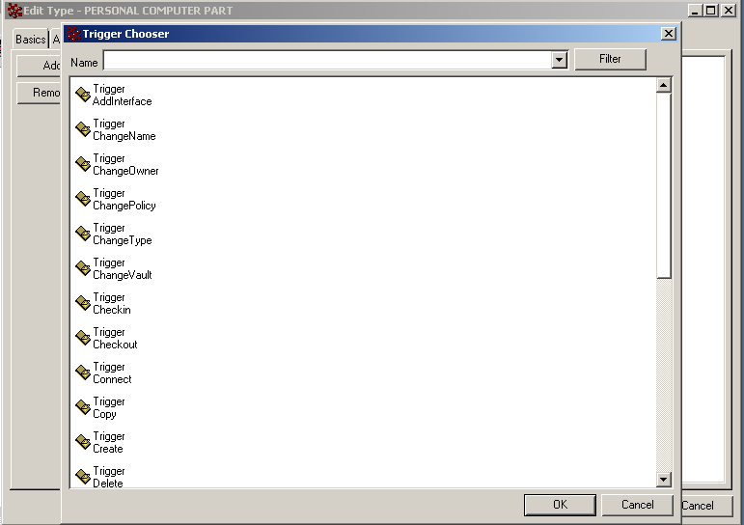

Supported Business Object Trigger Events
The following trigger events pertain to Business Object Types:
AddInterface
ChangeName
ChangeOwner
ChangePolicy
ChangeType
ChangeVault
Checkin
Checkout
Connect
Copy
Create
Delete
:
Disconnect
Grant
Lock
Modify
ModifyAttribute
ModifyDescription
RemoveFile
RemoveInterface
Revision
Revoke
Transaction
Unlock
3-84

Slide 75
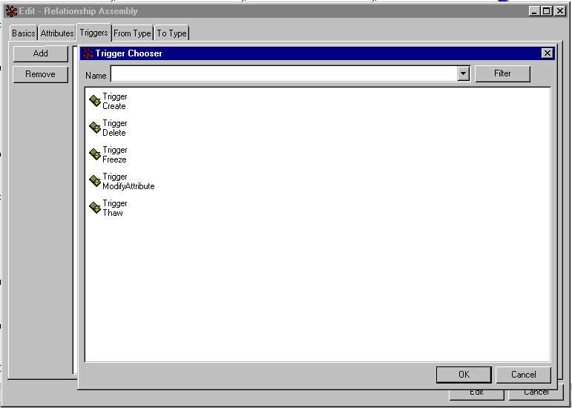
Supported Relationship Trigger Events
The following trigger events pertain to Relationships:
AddInterface
Create (connect)
Delete (disconnect)
Freeze
Modify
ModifyAttribute
ModifyFrom
ModifyTo
RemoveInterface
Thaw
Transaction
3-85

Slide 76
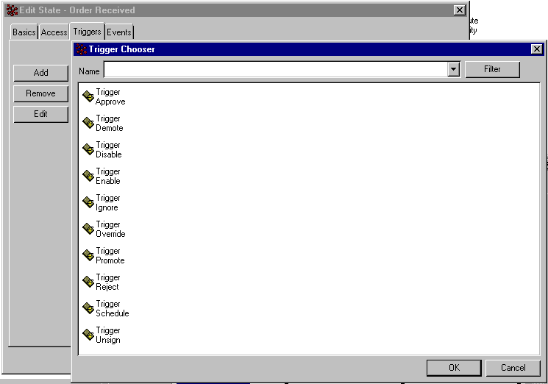
Supported Policy State Trigger Events
The following trigger events pertain to Policy states:
Approve
Demote
Disable
Enable
Ignore
Override
Promote
Reject
Schedule
Unsign
3-86

Slide 77
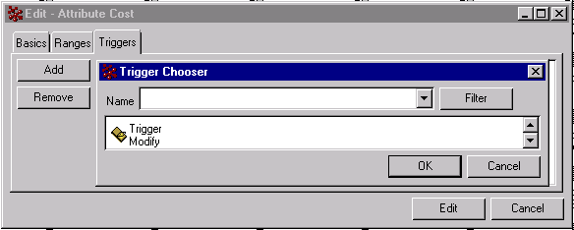
Supported Attribute Trigger Events
The following trigger event pertain to Attributes:
Modify
3-87

Slide 78
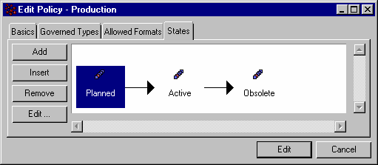
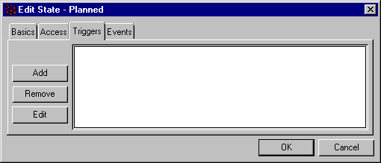
Assigning Program Objects to Trigger Events in Business Modeler (1/2)
To assign a program object to a Policy State Event, edit a Policy object in Business Modeler.
Double-click the Policy State to assign an event and Edit the event
Choose the Triggers-tab and then click Add to add a new trigger program:
3-88

Slide 79
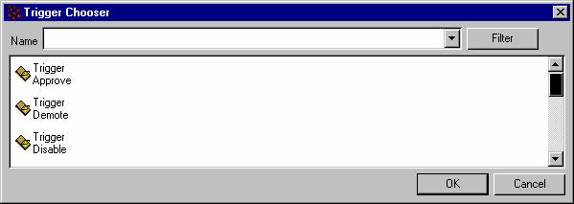
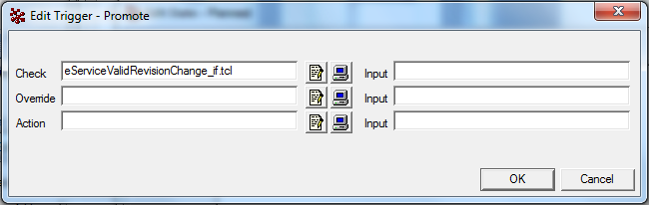
Assigning Program Objects to Trigger Events in Business Modeler (2/2)
Choose the event to add a trigger program:
Supply the Check, Override and/or Action trigger Program Object:
Note: Developers can pass one or more Input values to the Tcl Program Object they selected for the Check, Override or Action field. These input values must be entered in the Input field that displays along with the Check, Override or Action field. When providing multiple input values they must be specified space-separated.
The input values are automatically stored in the local RPE space along with the name of the Tcl Program Object. The name of the Tcl Program Object is stored in the local RPE variable named 0, the first Input value provided in the Input field is stored in the local RPE variable named 1, the second Input value provided in the Input field is stored in the local RPE variable named 2, etc.
Inside the Tcl Program Object the Developer will need to read out the Input values as follows: set Arg1 [mql get env 1] set Arg2 [mql get env 2] etc.

Slide 80
Trigger Program Types
There are three types of trigger programs to work with:
Check
Override
Action
3-90

Slide 81
Check Triggers
The check trigger executes before any of the normal system code that carries out the recognized event has a chance to execute.
It can be used to perform pre-event processing in anticipation of the event.
A check trigger program can block the event from actually occurring, aborting the event transaction, which means that no other trigger programs are executed. This is considered a ‘hard block’.
3-91

Slide 82
Override Trigger
The override trigger executes after the check trigger (if not blocked) and before the trigger event has a chance to execute.
It can be used to perform pre-event processing.
It can replace the normal event processing, with an alternate event, in effect performing a ‘soft block’ on the event.
3-92

Slide 83
Action Trigger
The action trigger executes after the event transaction is committed (whether the normal event took place or the override program replaced the event).
An action trigger is only executed if the previous event is successfully committed.
3-93

Slide 84
Trigger Timing Flow and Exit Codes
Check Triggers block an event by returning a non-zero value to the 3DEXPERIENCE Platform (“Hard”-block).
Override Triggers replace the current event by returning a non-zero value to 3DEXPERIENCE Platform (“Soft”-block).
Action Triggers ignore the return value.
Tcl trigger programs return a value to 3DEXPERIENCE Platform using the exit command.
Check
Override
Blocked?
EXIT 0
Replace Event?
EXIT 1
Event Replaced
EXIT 1
EXIT 0
Abort Event
Normal Event
Action
EXIT IGNORED
3-94

Slide 85
Example Check Trigger Program
tcl;
eval {
set iObjID "${OBJECTID}"
set nWeight [mql print bus $iObjID select attribute\[Weight\] dump]
if {$nWeight < 10} {
mql notice ”Object has invalid weight."
set RC 1
} else {
set RC 0
}
exit $RC
}
3-95

Slide 86
Soft Block
A Check Trigger program (“hard”-block) always displays a 3DEXPERIENCE Platform system error message (in ENOVIA Matrix Navigator only) indicating the blocked event.
Use the Override Trigger program to replace the event - in effect blocking the event.
Only the user-defined error message will be displayed.
Note that an Action Trigger program will still execute.
3-96

Slide 87
Trigger Transactions
Trigger Action programs are executed within the scope of the current transaction which may be nested.
Deferred Trigger Action programs are queued to execute outside the entire current transaction.
Necessary when the Action Trigger may rely on some data being committed to the database (e.g. reports, etc.).
3-97

Slide 88
Disabling Triggers
To disable triggers per MQL session (for importing new objects, etc.).
MQL Command:
trigger off; > Disable all trigger programs
trigger on; > Enable all trigger programs
User must be a 3DEXPERIENCE Platform System Administrator to execute this command.
3-98

Slide 89
Validate Query Trigger (1/6)
You can add a trigger to the query execution event so that administrators may control the types of queries that users are allowed to perform.
Trigger programmers can customize the behavior of queries (even block them from evaluating) depending on the query patterns specified.
The trigger is fired from the Find or ‘Find Like’ windows in ENOVIA Matrix Navigator (it’s enabled by default as long as a Program Object named ValidateQuery exists in the database).
The program will generally be designed to check the query patterns specified.
When changing query patterns, you must use global variables.
In MQL, the evaluate query and temp query commands can include the querytrigger clause, which will cause the ValidateQuery program to execute (if it exists).
For example:
temp query bus * * * querytrigger vault v1;
evaluate query q1 querytrigger;
Note: Studio Customization Toolkit methods are available to set and get the query trigger flag.
By default the flag is set to false. The methods are: public setQueryTrigger(boolean queryTrigger) public boolean getQueryTrigger()
3-99

Slide 90
Validate Query Trigger (2/6)
The ValidateQuery trigger has two main purposes:
To block certain types of queries that perhaps are inefficient.
To change the query patterns in the background to perform a more specific query than originally attempted.
Example: If the vault pattern is a wildcard (*), the value can be changed to be a list of all vaults instead.
3-100

Slide 91
Validate Query Trigger (3/6)
In addition, customized error and notice messages can be created.
Example: In the case of a blocked query, the program may display a message that indicates the reason for blocking it, such as more information is required.
The validate query trigger is different from other 3DEXPERIENCE Platform triggers. It executes a single program that works as a combined check and override trigger, and is designed as a way to modify the current query (via the RPE). The validate query trigger is fired before the query is evaluated.
3-101

Slide 92
Validate Query Trigger (4/6)
Example 1: Change the vault pattern in the background if only a wildcard is provided.
tcl; eval { set sVault [ mql get env VAULT_PATTERN ] if { $sVault=="*" } { set sVault "vault1,vault2,vault3" mql set env global VAULT_PATTERN $sVault } exit 0 }
3-102

Slide 93
Validate Query Trigger (5/6)
Example 2: Do not allow end-users to run queries that specify wildcard values for TNR. tcl; eval { set sType [ mql get env TYPE_PATTERN ] set sName [ mql get env NAME_PATTERN ] set sRev [ mql get env REVISION_PATTERN ] if {$sType == "*" && $sName == "*" && $sRev == "*"} { mql notice "You specified wildcards for TNR. Please specify characters other than * for TNR.“ set RC 1 } else { set RC 0 } exit $RC }
3-103

Slide 94
Validate Query Trigger (6/6)
If the exit code is a non-zero value, a soft block occurs. In this case the query as entered is not executed; the query event is overridden and the transaction is committed, closing the Find or ‘Find Like’ window.
It is up to the query trigger program code that overrides the query to generate a message to inform the user that the query did not get executed.
3-104

Slide 95
Turning Triggers Off
Turning off triggers
ALL triggers can be turned OFF from mql by giving the command:
trigger off;
This is valid only for that particular session of MQL.
To turn ON triggers, give the command:
trigger on;

Slide 96
Validation (Check) Trigger
In this step you will build a validation trigger program:
The Vice President has noticed that the Cost is sometimes missing from a PART when he approves a lifecycle state in the Production policy. This is causing problems in Accounting and needs to be corrected.
When an authorized person promotes a PART in the Production policy, the promotion should fail with a warning message box if the Cost is not greater than 0.
10 minutes
3-105

Slide 97
Do It Yourself
Create a Program Object that gets the attribute Cost from the current business object.
If the cost is not greater than zero present an mql warning messagebox to the user and return a non-zero value.
Add a Promote trigger to the Planned state of the Production policy.
Attach the Program Object you created in Step 1-2 to the Promote trigger. What kind of trigger should this be?
You will note that two error messages are presented when the trigger event is blocked. One from 3DEXPERIENCE Platform and one user-defined from your program.
Change the location of the program you have just created so that a 'soft block' occurs instead. A soft block will only display the user-defined error message. What are the ramifications of using a ‘soft’ block vs. a Check trigger ('hard' block)?
3-106

Slide 98
Extend (Action) Trigger
In this step you will build an action trigger program:
Dave has requested that 3DEXPERIENCE Platform should automatically promote all the subassemblies of a System Box when the System Box is promoted. Currently each component must be promoted individually.
The authorized user should be able to select a System Box and promote to the Active state. This promotion should automatically promote all the subassemblies of the System Box that need to be promoted as well.
20 minutes
3-107

Slide 99
Do It Yourself
Create a Program Object that obtains the business object name (TNR) of the currently selected system box using Program Macros.
Add an mql expand bus command that lists all the subassemblies of the current System Box to a variable.
Split the string returned from the expand command using the newline ('\n') delimiter into a list variable.
Add a foreach loop that extracts the current subassembly from the expand list created in Step 3.
Split the current assembly value into a list variable.
Use the lindex command to get the business object name (T N R) from the assembly value.
Use the mql approve command to automatically sign off on the subassembly object.
Use the mql promote command to promote each subassembly object.
Add the trigger to the Planned state of the Production policy. Which trigger type should this be?
3-108

Slide 100
Introduction – RPE
When a 3DEXPERIENCE Platform Program completes execution, all Tcl variables (and their values) that have been set are released from memory.
To retain specific values across programs, requires the use of the Runtime Program Environment (RPE).
The (RPE) is the mechanism used to pass and collect information between Program Objects within the same instance of 3DEXPERIENCE Platform.
The (RPE) contains named program environment variables that store string values
Information can be passed between 3DEXPERIENCE Platform Programs.
Macro values can also be obtained from the RPE.
3-72

Slide 101
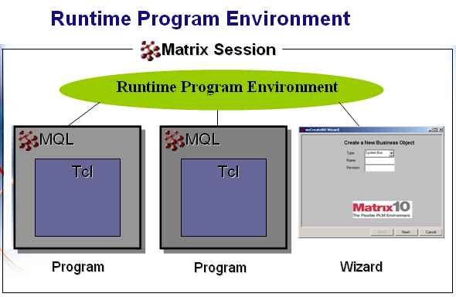
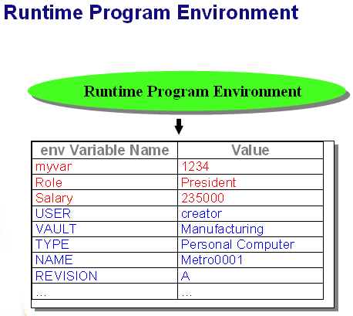
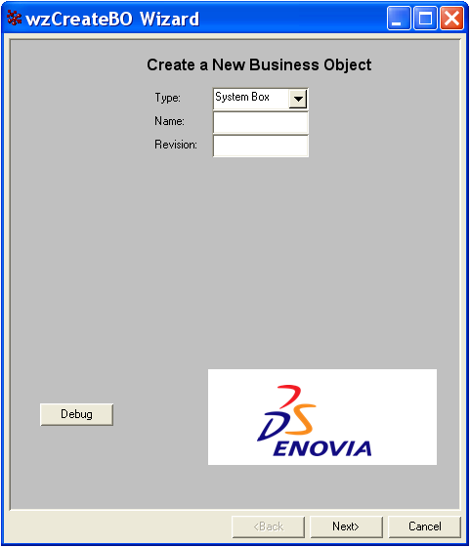
Runtime Program Environment (RPE)
Wizard
3-73

Slide 102
Macros
Some standard MACROS are defined which can be used to get information in the trigger program about the object on which the trigger is fired. All the macros are substituted with their resolved values before the trigger is executed.
Some commonly used macros are: OBJECTID, TYPE, NAME, REVISION, USER.
They are accessed from mql in the following way: ${MACRO_NAME}
e.g. tcl;
eval {
set objectName ${NAME}
}

Slide 103
RPE Commands
The following MQL commands can be used to manipulate RPE variables:
set env [global] NAME VALUE;
get env [global] NAME;
unset env [global] NAME;
list env [global];
clear env; (Can only be issued by a System Administrator)
exists env [global] NAME;
listnames env [global];
3-74

Slide 104
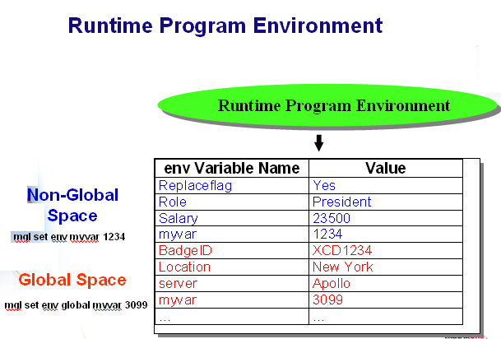
Global RPE
On ENOVIA Matrix Navigator (thick client), 3DEXPERIENCE Platform maintains two memory spaces for RPE variables/values.
The webtop applications (ENOVIA Live Collaboration Server) saves the RPE variables to a subdirectory of the ENOVIA Live Collaboration Server installation, viz.: enoviaV6R2013x\server\workspace
Non-global variables are deleted when the program from which they were issued ends.
Global variables persist for the life of a 3DEXPERIENCE Platform session or when they are unset or cleared using an RPE command.
To access the global space use the global keyword as part of the RPE Command.
3-75

Slide 105
RPE and 3DEXPERIENCE Platform Macros
All 3DEXPERIENCE Platform Macros are also available in the RPE as local RPE variables.
Macro: | RPE Variable:
“${TYPE}” | mql get env TYPE
“${USER}” | mql get env USER
${OBJECTID} | Mql get env OBJECTID
While MACRO values are available from the RPE, keep in mind that in a situation with multiple ENOVIA Live Collaboration Servers, there may be more than one version of the RPE. Be cautious when using the RPE values dynamically in your code.
3-76

Slide 106
Program Macros for Trigger Programs (1/6)
3DEXPERIENCE Platform provides a collection of Program Macros that are useful for working with Trigger Programs. The macros are categorized in the following way:
Standard Macros
Context/Access Macros
Business Object Macros
State Macros
Signature Macros
Relationship Macros
Attribute Macros
3-77

Slide 107
Program Macros for Trigger Programs (2/6)
Standard Macros, Context/Access Macros and Business Object Macros:
Category: | Macro: | Meaning:
Standard Macros | TIMESTAMP | The current date/time
 | EVENT | Most recent transaction performed
Context/Access Macros | USER | Current User
 | ACCESSFLAG | Access flag (True if USER will be allowed to perform event)
 | CHECKACCESSFLAG | Check access flag (False when access is not checked, such as during import)
Business Object Macros | OBJECT | Used for Business Object Identification
 | TYPE
 | REVISION
 | OBJECTID
 | POLICY | Further Business Object Details
 | VAULT
 | OWNER
 | DESCRIPTION
 | ENFORCEDLOCKING
 | CURRENTSTATE
 | LOCKFLAG
 | LOCKER
3-78

Slide 108
Program Macros for Trigger Programs (3/6)
State Macros:
Category: | Macro: | Meaning:
State Macros | ISENABLED | Boolean State Flags
 | ISDISABLED
 | ISOVERRIDDEN
 | ISCURRENT
 | ISREVISIONABLE
 | ISVERSIONABLE
 | HASSCHEDULEDATE
 | HASACTUALDATE
 | AUTOPROMOTE
3-79

Slide 109
Program Macros for Trigger Programs (4/6)
Signature Macros:
Category: | Macro: | Meaning:
Signature Macros | SIGNATURE | Current Signature Name
 | ISSIGNED | Boolean Signature Flags
 | ISAPPROVED
 | ISREJECTED
 | ISIGNORED
 | EXISTINGSIGNER | If signed, the signer’s Name
 | EXISTINGCOMMENT | Associated comment, if any
3-80

Slide 110
Program Macros for Trigger Programs (5/6)
Relationship Macros:
Category: | Macro: | Meaning:
Relationship Macros | RELTYPE | Relationship Name
 | FROMMEANING | From-side meaning
 | FROMOBJECTID | ObjectId of Business Object connected on From-side
 | FROMTYPES | From Business Types allowed (excluding child Types)
 | FROMALLFLAG | Boolean flag – True if all Business Types allowed
 | FROMREVACTION | Revision action of Object at From-side. Possible values: Float, Replicate and None
 | FROMCARD | Cardinality of From-side, Possible values: One or N
 | TOMEANING | Associated comment, if any
 | TOOBJECTID | ObjectId of Business Object connected on To-side
 | TOTYPES | To Business Types allowed (excluding child Types)
 | TOALLFLAG | Boolean flag – True if all Business Types allowed
 | TOREVACTION | Revision action of Object at To-side. Possible values: Float, Replicate and None
 | TOCARD | Cardinality of To-side, Possible values: One or N
3-81

Slide 111
Program Macros for Trigger Programs (6/6)
Attribute Macros:
Category: | Macro: | Meaning:
Attribute Macros | ATTRNAME | Name of attribute
 | NEWATTRVALUE | Value of attribute about to be committed
 | ATTRVALUE | Current attribute value in database
 | ATTRTYPE | Attribute type. Possible values are: Integer, Real, String, Boolean or Date)
 | ATTRDEFAULT | Default value of attribute
 | ATTRCHOICES | Range values of Attribute
3-82

